Slide 1


Evaluating readiness for sustainable market growth
Online Retail Expansion Analysis
Market Expansion Feasibility Overview
Market analysis Presentation
Presented By:
PRASHANT KUMAR

Slide 2
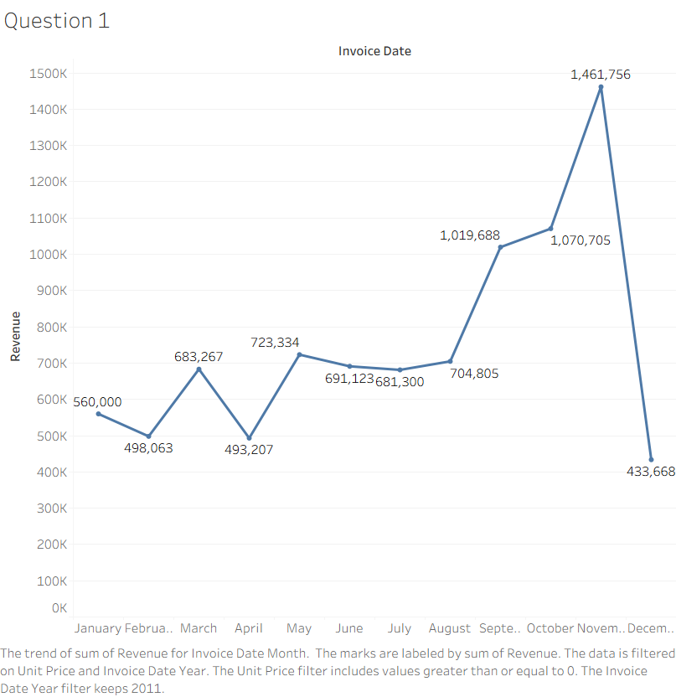

Question 1: 2011 Monthly Revenue (Line Chart)

Slide 3
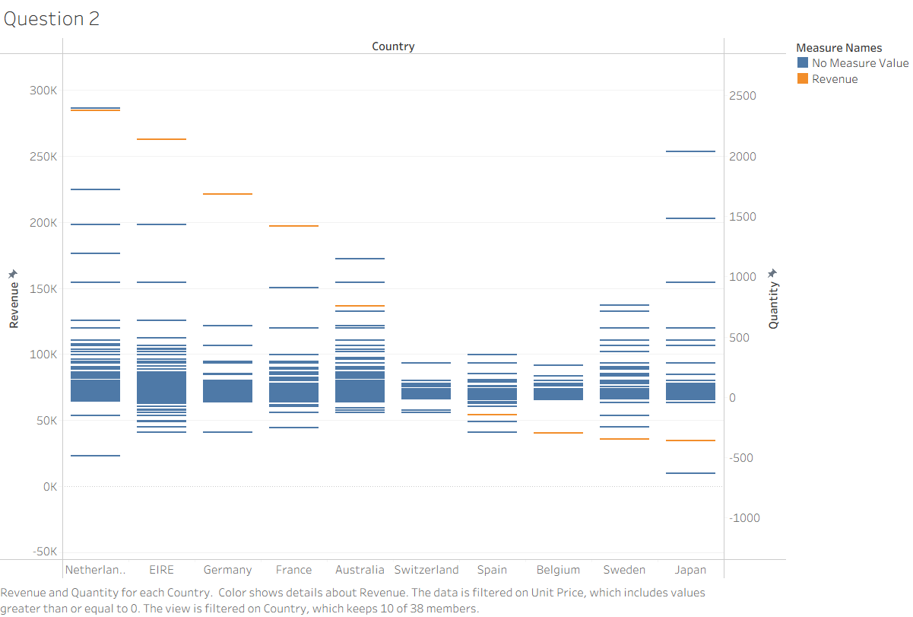
Question 2: Top 10 Countries by Revenue & Quantity (Clustered Column Chart)

Slide 4
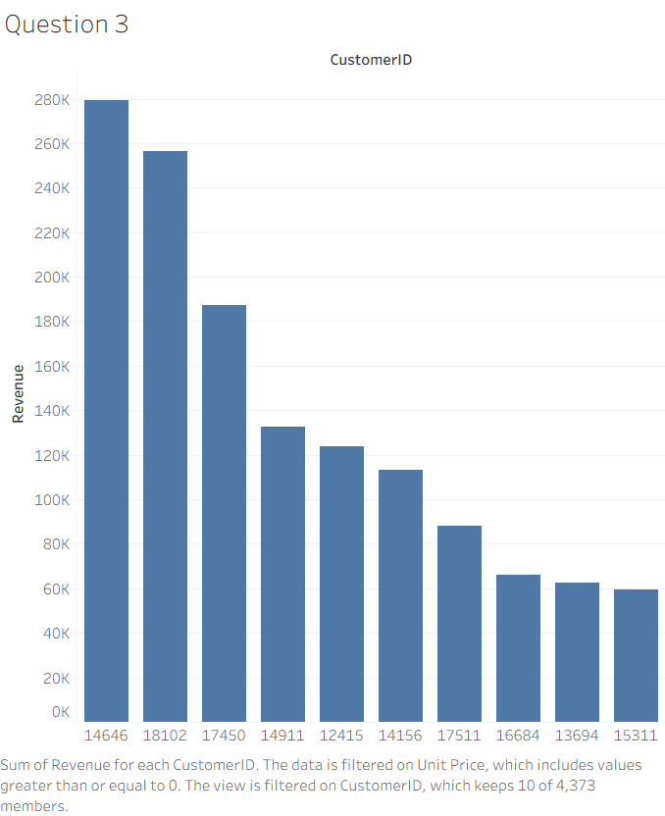
Question 3: Top 10 Customers by Revenue (Sorted Column Chart)

Slide 5
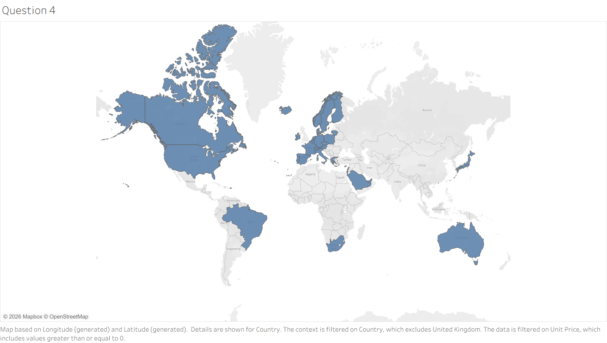
Question 4: Global Demand Map (Filled Map)

Slide 6





Thank you so much
+91 8941863821
prashantkumar26664@gmail.com
https://www.linkedin.com/in/prashantkumar034/

